Slide 1

Working title: RANS-Based Study on the Impact of Complex Terrain and Wind Effects on Golf ball Trajectories
Bachelor project, 2026
Meeting 5, date: 14-04-2026
GROUP 3
Eske Freiesleben
Jacob Manniche
J. Alfred Pedersen
Student ID
S234229
S234258
S230869

Slide 2
Reworked title and research questions
Tentative title
RANS-Based Study on the Impact of Complex Terrain and Wind Effects on Golf ball Trajectories
Research questions
What meaningful differences arise in trajectories when comparing static uniform wind fields and wind fields from RANS simulations, for standardized golf shots over flat terrain?
How does wind direction and surface roughness impact trajectories for golf shots over flat terrain?
What is the impact of varying wind conditions in a fairway corridor lined by tree lines on both sides?
Is there a meaningful impact on trajectory by including stochastic TKE-based variations to RANS simulated wind fields
Bachelor project:
CFD and ROM of Flow over a Golf Court

Slide 3
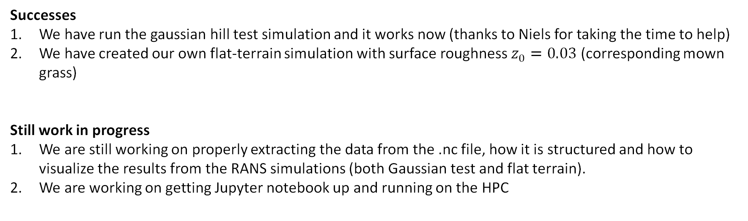
G-bar/HPC update
Successes
We have run the gaussian hill test simulation and it works now (thanks to Niels for taking the time to help)
We have created our own flat-terrain simulation with surface roughness $z_{0}=0.03$ (corresponding mown grass)
Still work in progress
We are still working on properly extracting the data from the .nc file, how it is structured and how to visualize the results from the RANS simulations (both Gaussian test and flat terrain).
We are working on getting Jupyter notebook up and running on the HPC
Bachelor project:
CFD and ROM of Flow over a Golf Court

Slide 4
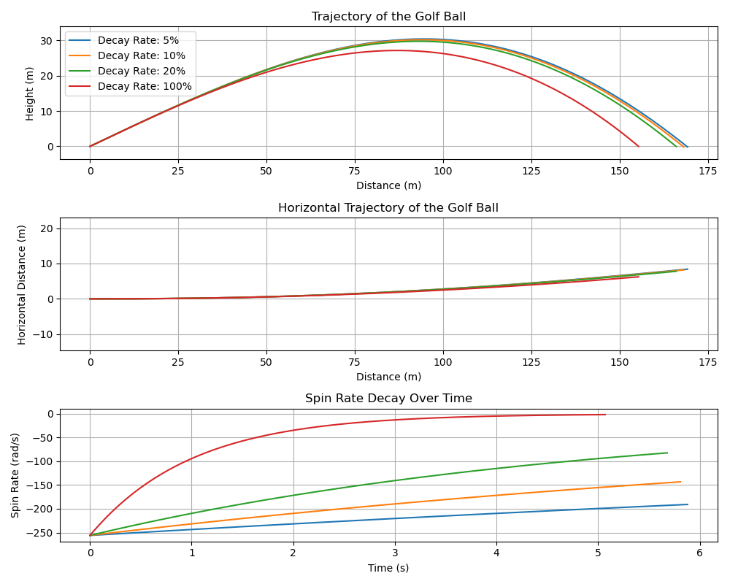
Trajectory model update
Decay rate seems to have very little effect on trajectory.
Error or reality?
Bachelor project:
CFD and ROM of Flow over a Golf Court

Slide 5
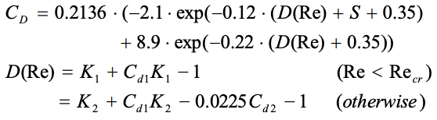
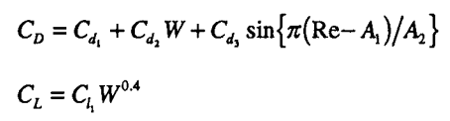
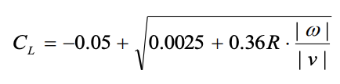
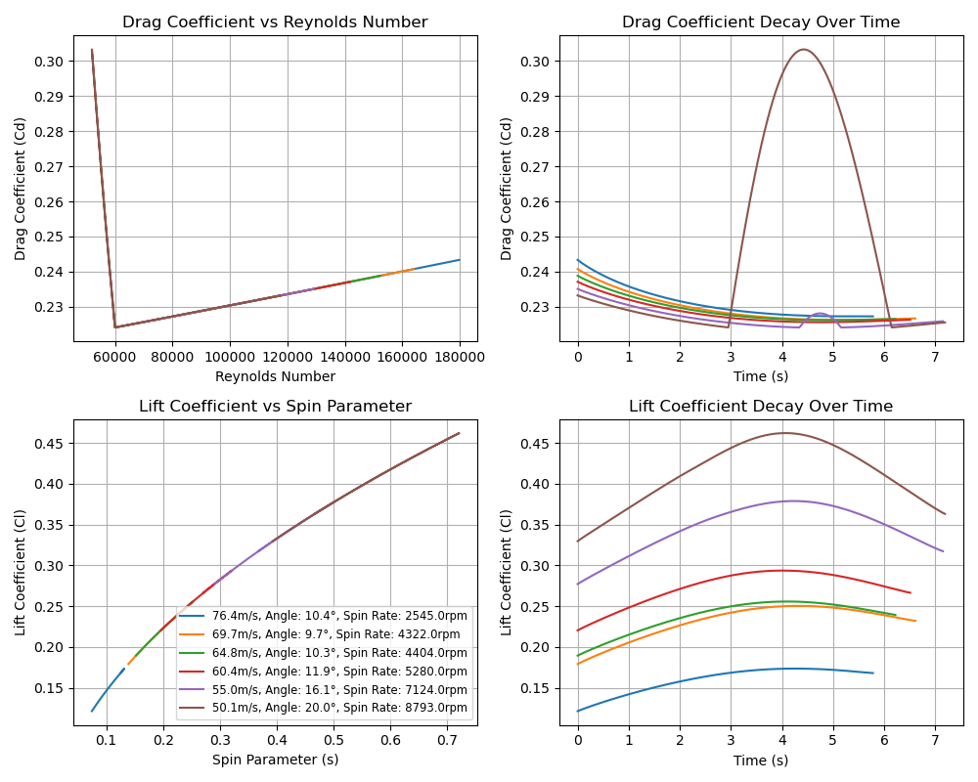
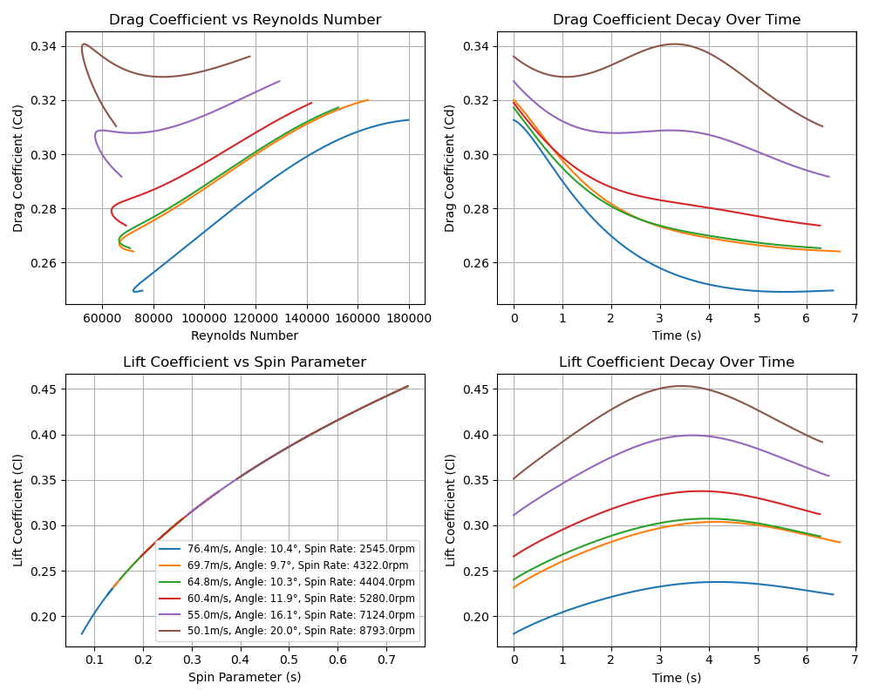
Trajectory model update
Baek, 2013
A.J. Smits, 1994
Bachelor project:
CFD and ROM of Flow over a Golf Court

Slide 6
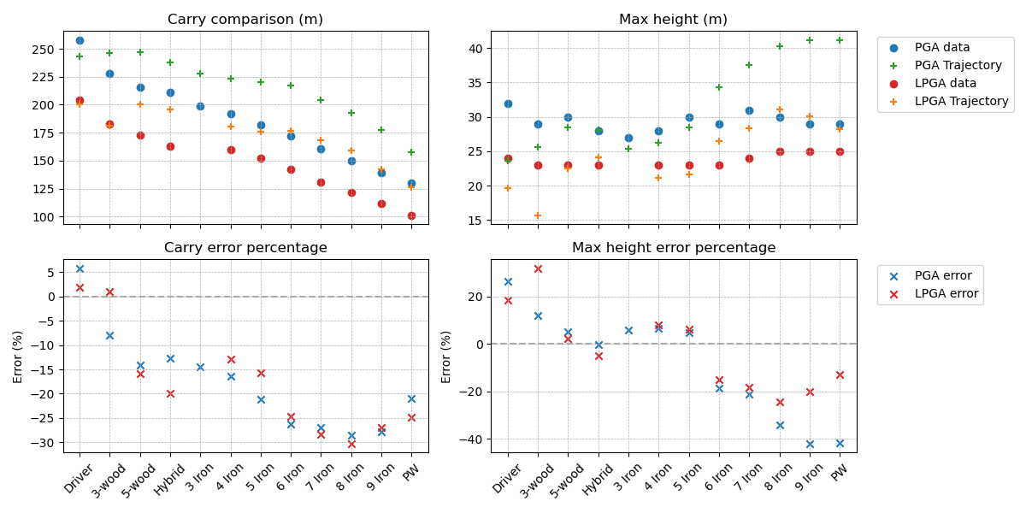
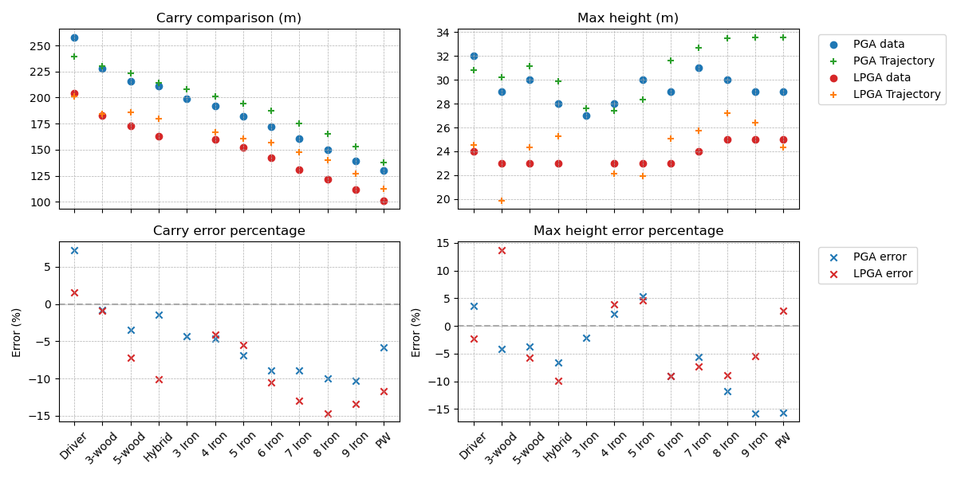

Trajectory model update: Carry
Bachelor project:
CFD and ROM of Flow over a Golf Court

Slide 7
Trajectory model update: Max height
Bachelor project:
CFD and ROM of Flow over a Golf Court

Slide 8
Trajectory: Uniform vs log
Logarithmic wind
U(z)=(u*/kappa)*ln(z/z0)
Uniform wind
Calculated as the average wind speed of U(z) in the domain from the ground to the highest point in the log wind golf ball trajectory
Bachelor project:
CFD and ROM of Flow over a Golf Court

Slide 9
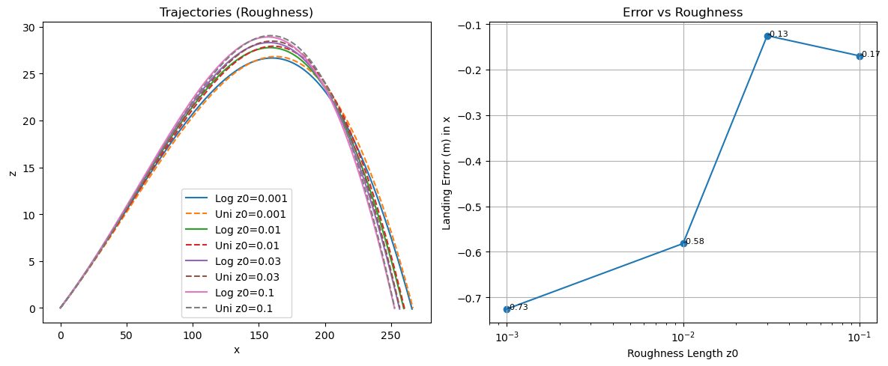
Uniform vs log: roughness
For a standardized shot with; speed = 76.4 m/s, angle = 10.4, spin= -2545 rpm
Bachelor project:
CFD and ROM of Flow over a Golf Court

Slide 10
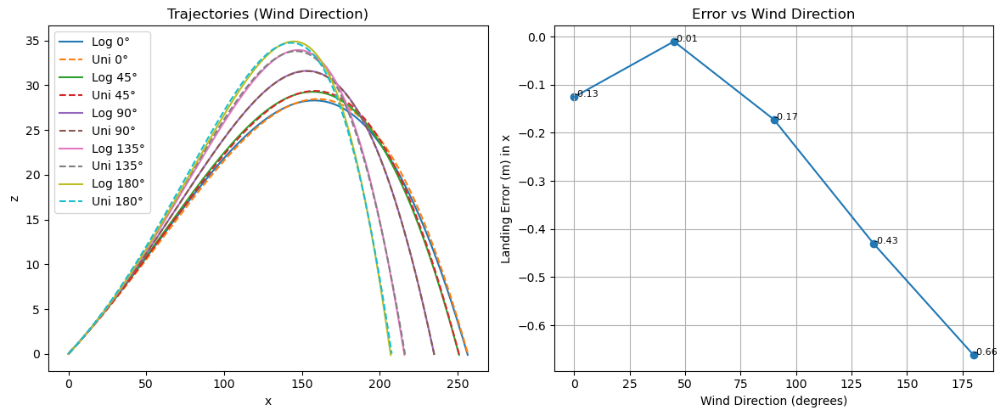
Uniform vs log: Wind direction
For a standardized shot with; speed = 76.4 m/s, angle = 10.4, spin= -2545 rpm
Bachelor project:
CFD and ROM of Flow over a Golf Court

Slide 11
Important date
Final oral defense possible before june 4th?
Bachelor project:
CFD and ROM of Flow over a Golf Court

